Slide 1
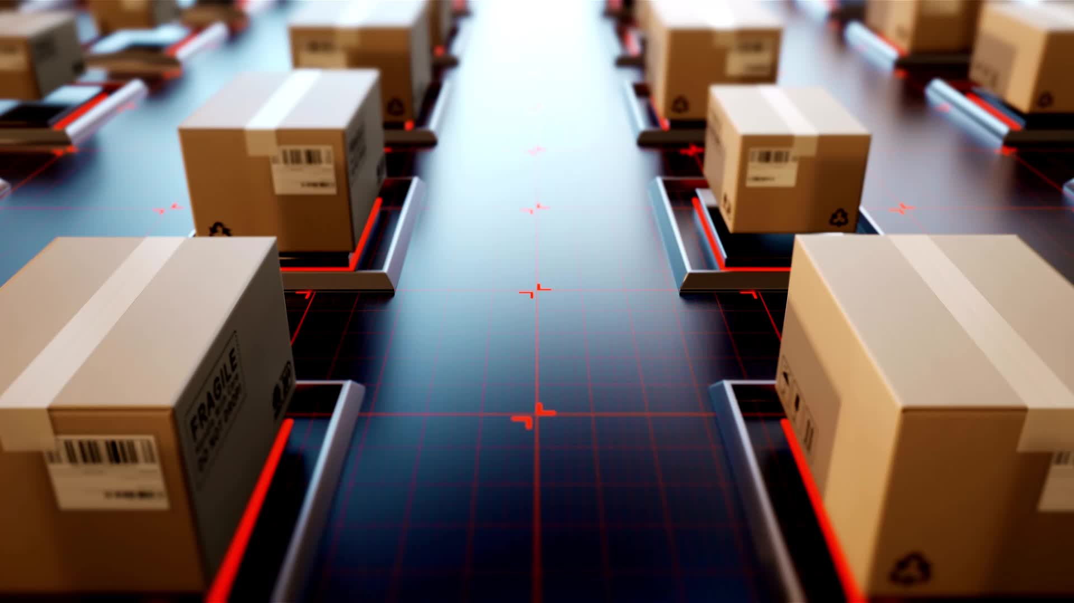
Objective
Better Monitoring of the overall activity by using the logs provided by the Automation system.
Mitigate chances of manual fallacy.
Faster Delivery Processing.
Reduce the Duration of time-consuming activities.
Leverage Automation to improve the overall performance and reliability of the Department.

Slide 2
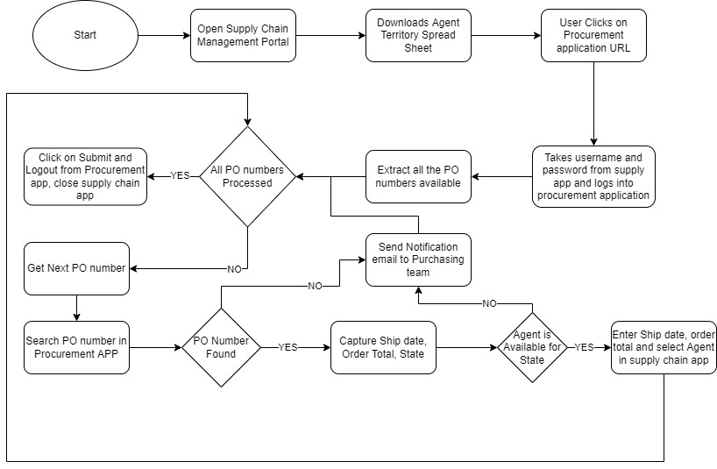
Process and Workflow
The first step in Supply Chain Management PO Tracking using the Robotic Enterprise framework is to launch a browser and Automation Anywhere. The Agent Territory Spreadsheet needs to be downloaded. After that, the system verifies whether the data in the excel file is actually available. The automation process continues if the data is available and ends if it is not. Once the data has been copied, the automated procedure opens the URL for registering for bank loans and fills out the loan application. It creates a special loan ID and adds it to the relevant customer's information in the excel file. However, the system evaluates and verifies each customer's data in several ways, such as age, name, email, loan amount, etc., before creating the loan ID. This makes sure that every piece of information is available, and that no customer's data is missing. Instead of creating a loan ID when any of the data is missing, the automation process adds a note.

Slide 3
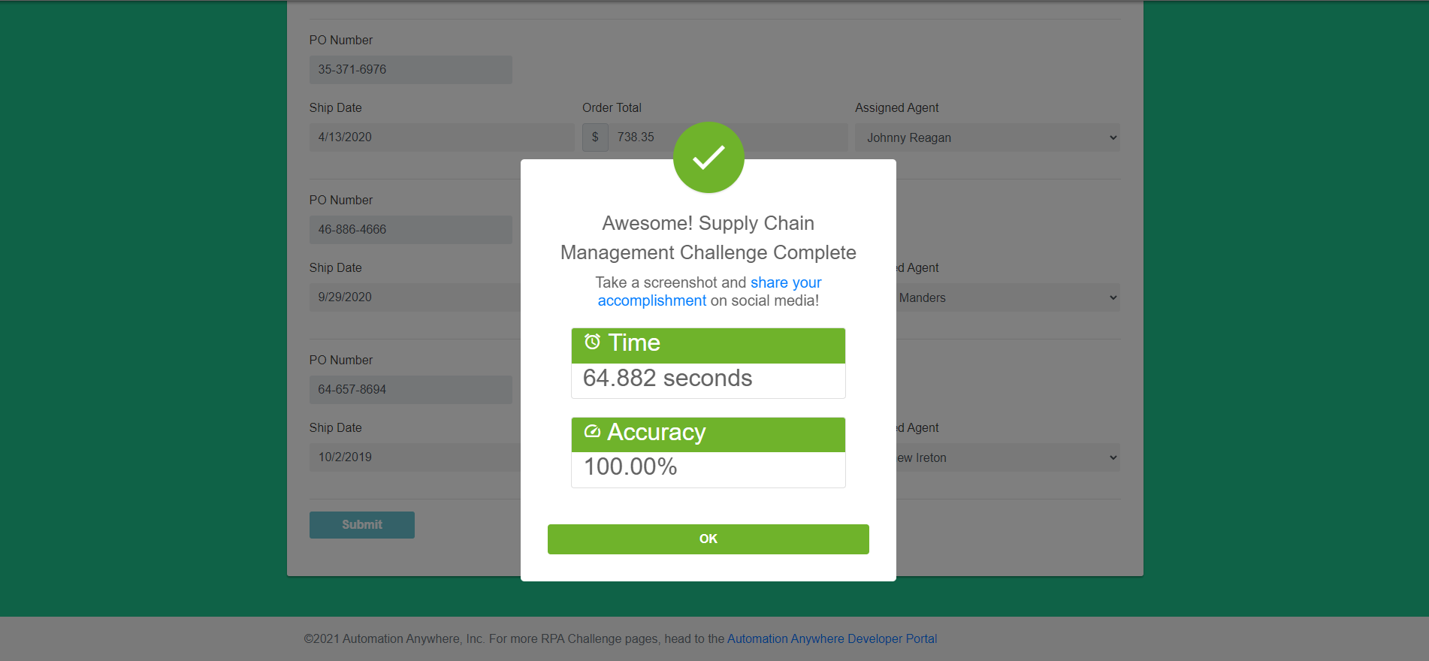
Output

Slide 4
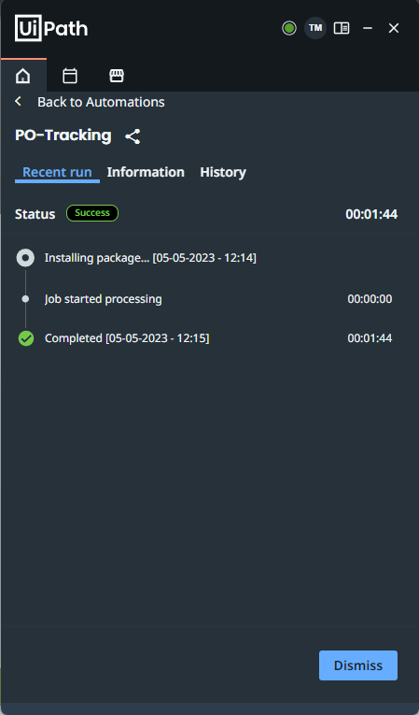
Supply Chain Management PO Tracking Execution Timing

Slide 5


